Slide 1
Probe Data Analysis and Road Slope
By:
Abhishek Krishna Vandadi(A20426749)
Nital Milind Bansode(A20427196)
Amitdeb Prasad Bhattacharya(A20402789)
Karthik Mahesh(A20383027)

Slide 2
INPUT
1) Partition6467ProbePoints.csv
This file contains raw probe points.
2) Partition6467ProbePoints.csv
This file contains linkdata for the links that the probe points can be map
matched to.

Slide 3
Tasks
Map matching probe points to road links
Derive road slope for each road link
Evaluate the derived road slope with the surveyed road slope in the link data file

Slide 4
Programming Language used:
Python

Slide 5
STEPS FOR WRITING THE CODE
Step 1:
Create and define a class to find latitude and longitude for given points. We define it using shape attributes here.
Step 2:
Create a class which we can use to package the LinkData csv into a package object. The start and end data points are passed to the class which packages it into the class variables. It should contain function which can be used to calculate the distance between a packed linkData and a new probe-point. It should also consist of a function which can be used to calculate distance between two links i.e. LinkData is passed.
Step 3:

Slide 6
STEPS FOR WRITING THE CODE
Step 3:
Create a class used to package the sample ID data set into an object which also contains function used to find the direction and a function used to convert the object to string and return the required format.
Step 4:
Create a class used to package the sample ID data set into an object with scope object appended to the return list. It should also have a function used to convert the object to string and return the required format with scope appended.

Slide 7
STEPS FOR WRITING THE CODE
Step 5:
Create a Class used to package the linkData used to calculate the slope and evaluate it.
Step 6:
Create and define a function used to read the linkData from the csv and create linkDataList/pointDataList. Iterate through the link data to form the package by passing into the class.

Slide 8
STEPS FOR WRITING THE CODE
Step 7:
Create a function used to match the linkDataList with the probe data and find the shortest distance. If the probe point is empty or less than the distance find the direction b/w the point and the linkdata.
Step 8:
Create a function used to find distance between two data points (latitude and longitude) with respect to earth avg rad. We have to Convert values to Km with respect with earth radius.

Slide 9
STEPS FOR WRITING THE CODE
Step 9:
We have to create a function used to find the slope of the road link. We can do it by creating the linkArray with linkdata csv (converted in respective package).
Step 10:
We have to create a function used to evaluate the derived road slope with the surveyed road slope in the link data file. We do this by checking for matched point in the node, splitting the slopeInfo to form an array of slopes, looping through each element and finding the sum in the slope group, and finally looping through each element and finding the sum in the slope group.

Slide 10
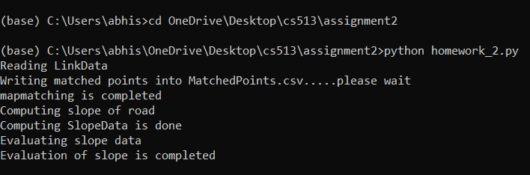
Screenshots of execution and output

Slide 11
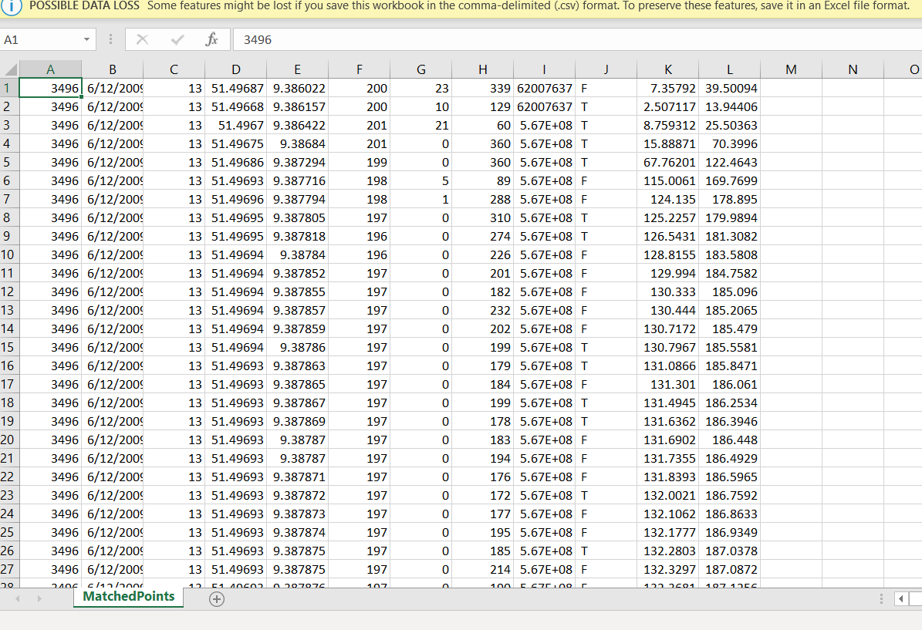

Slide 12
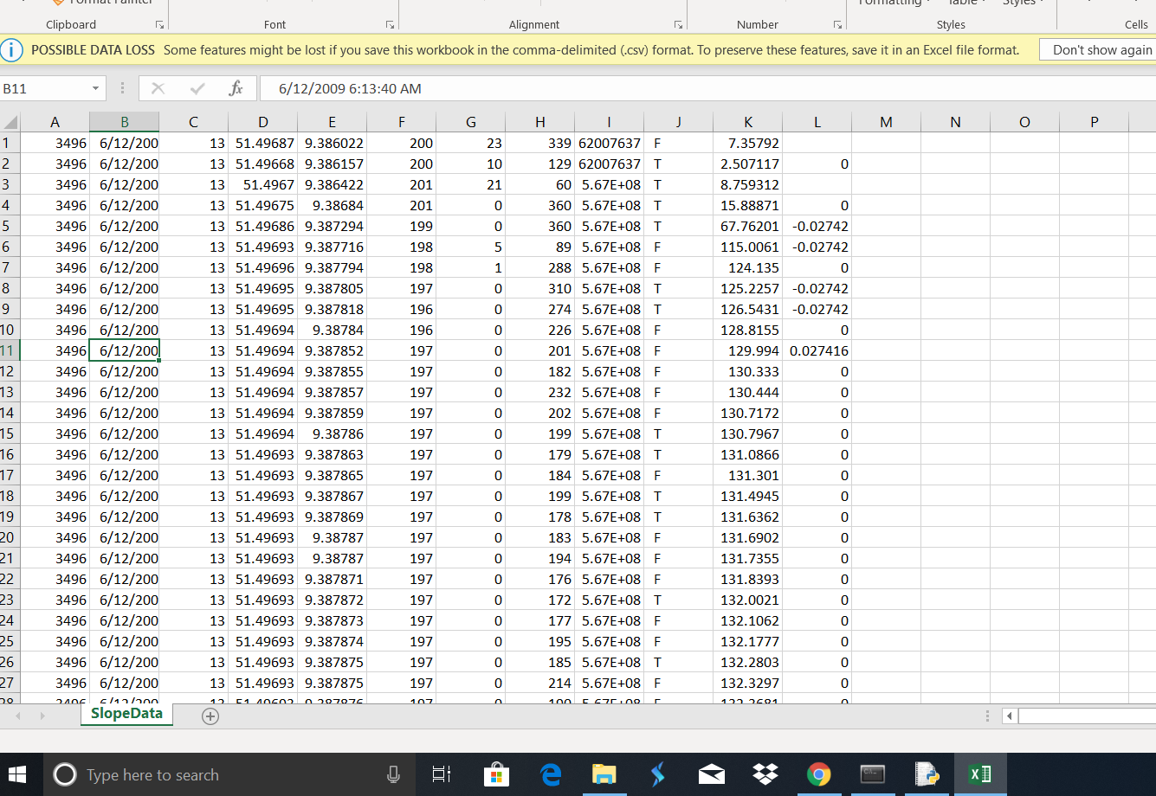

Slide 13
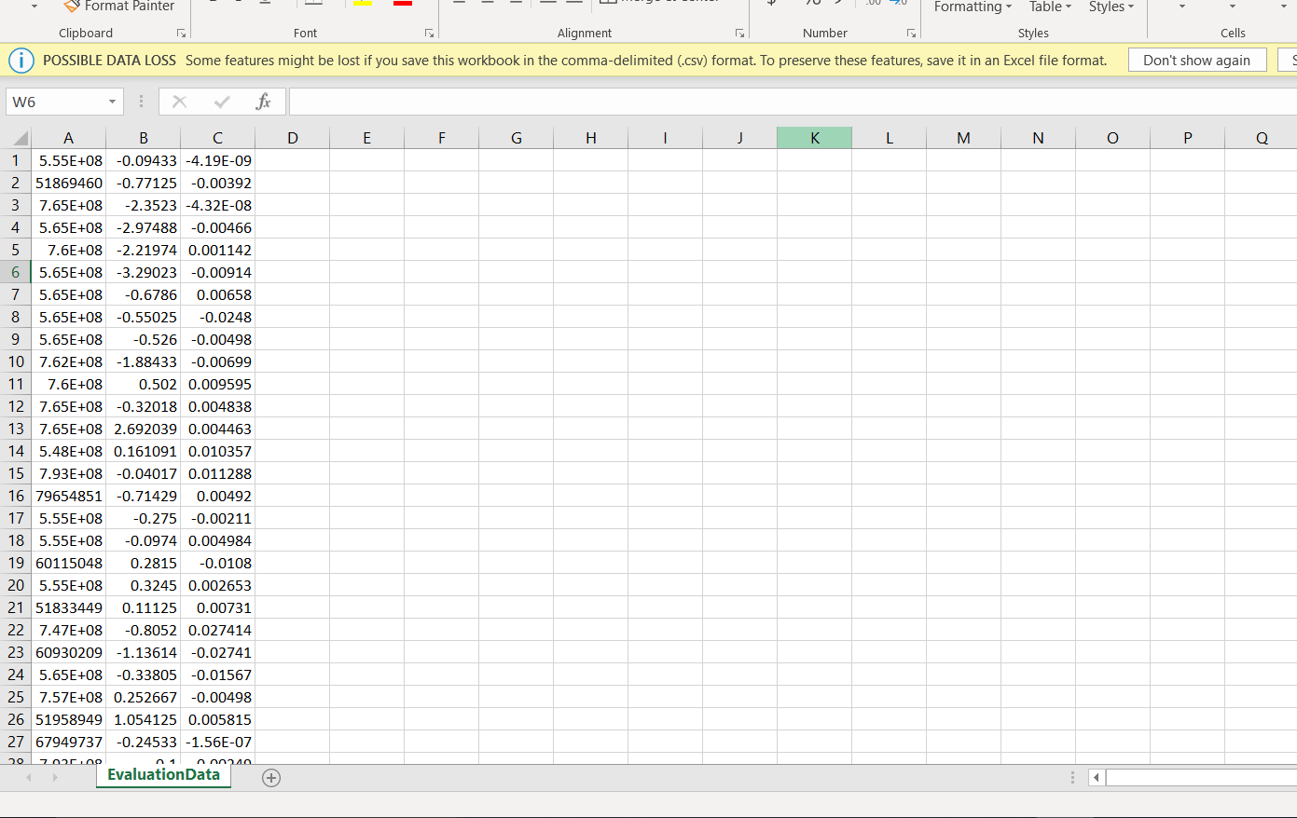

Slide 14
Thank You

